Slide 1
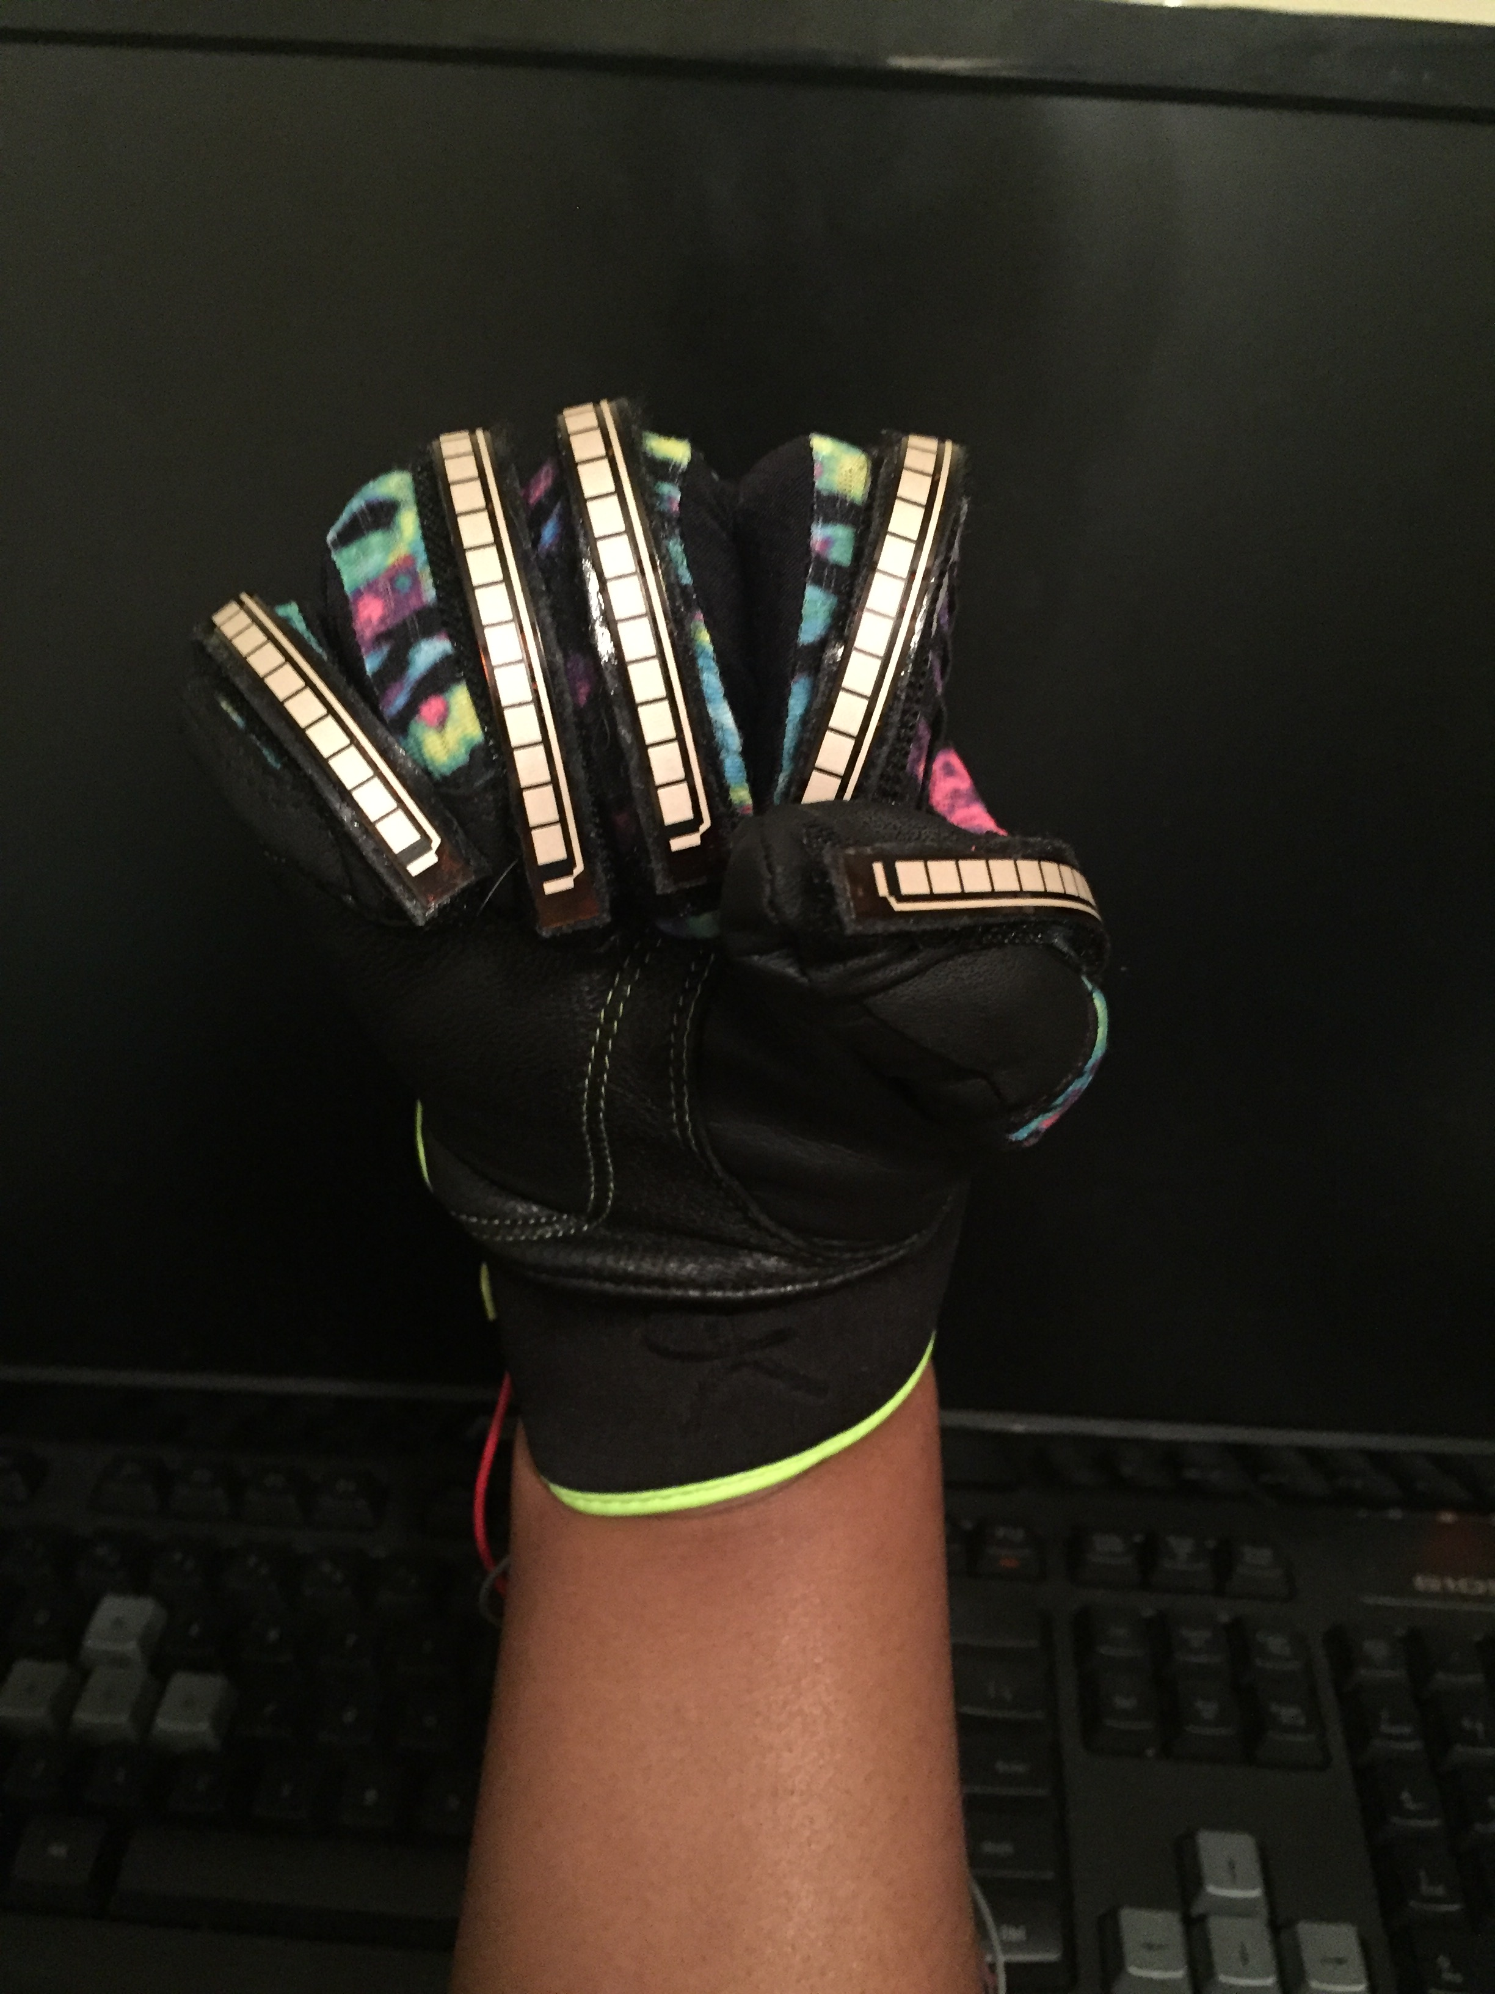
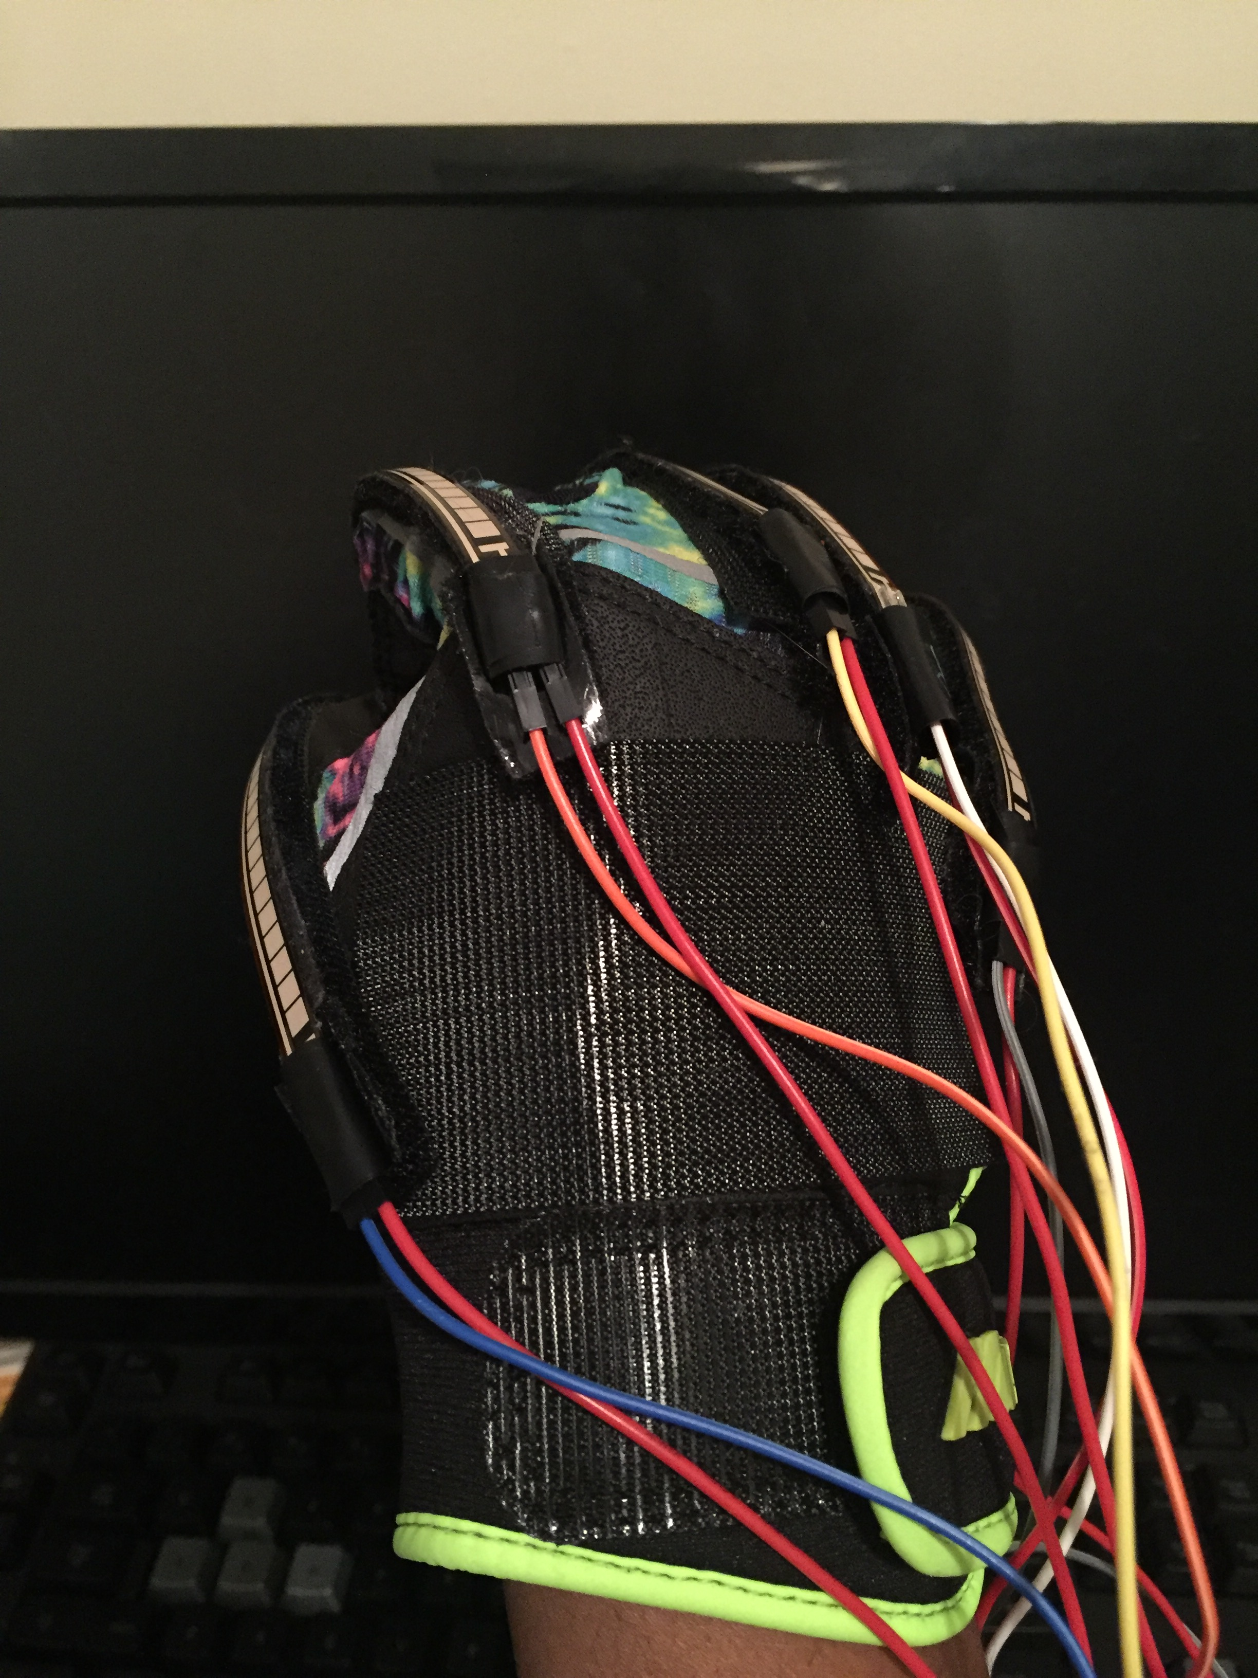
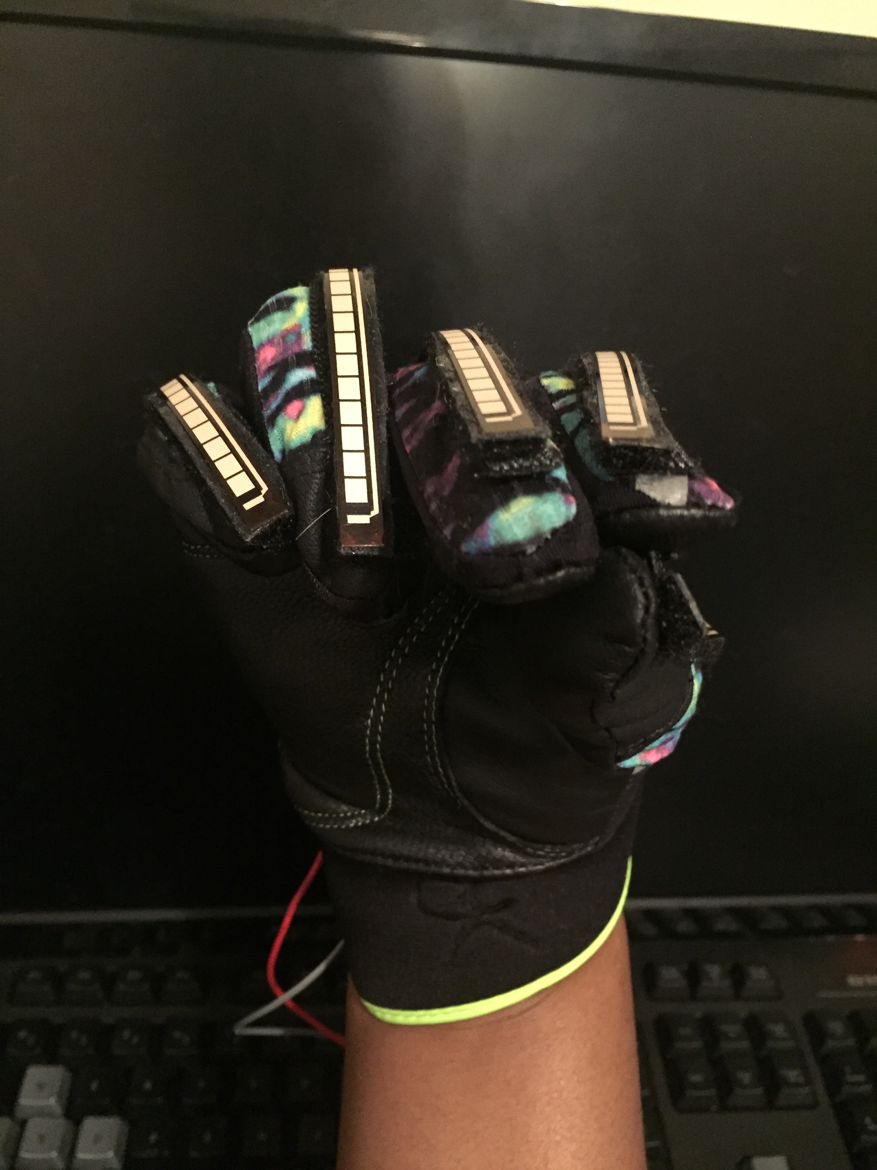
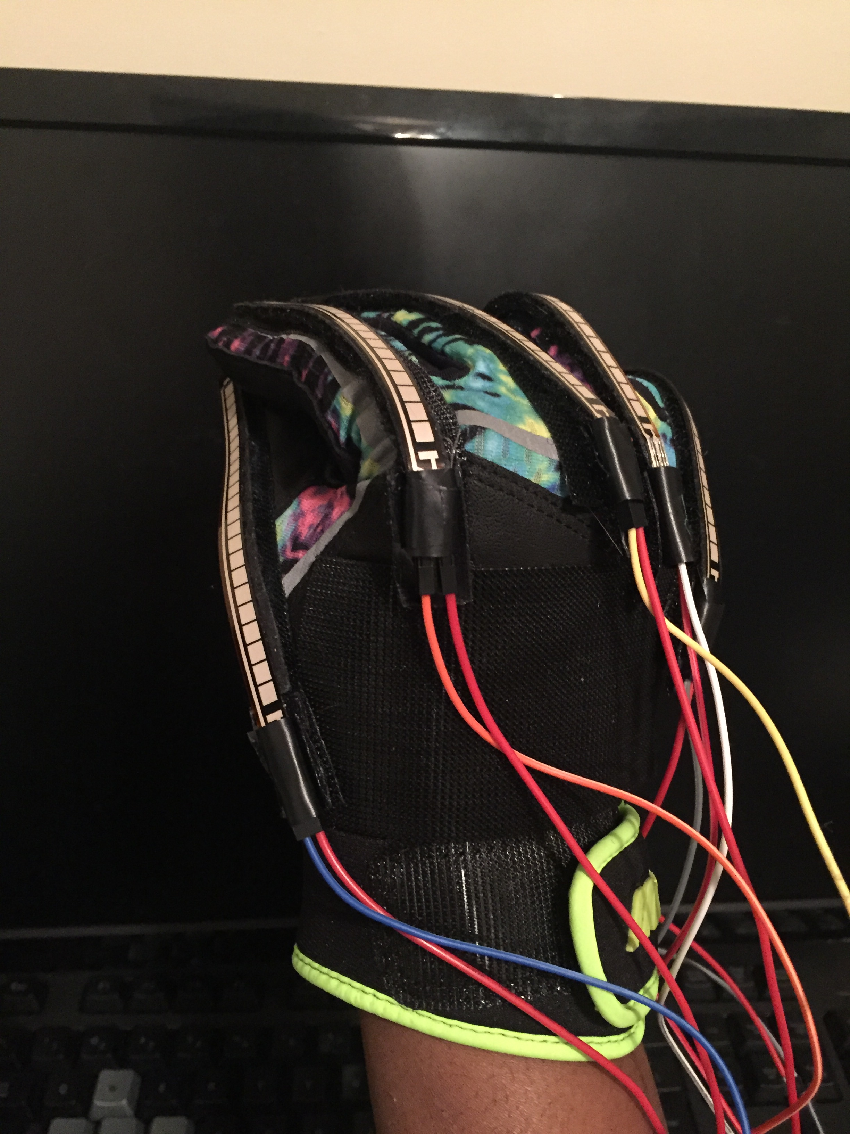
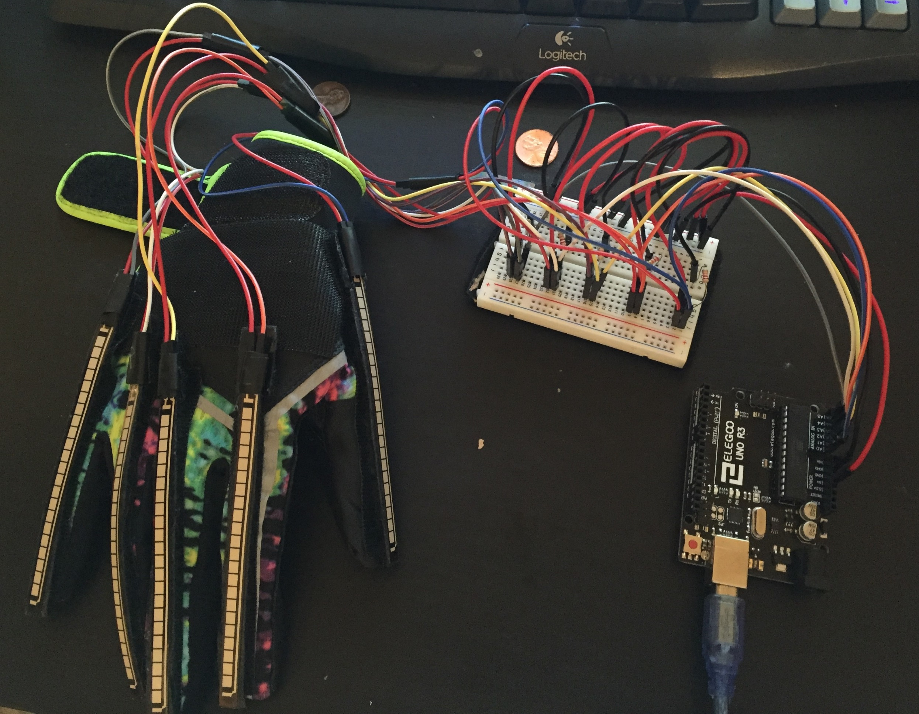
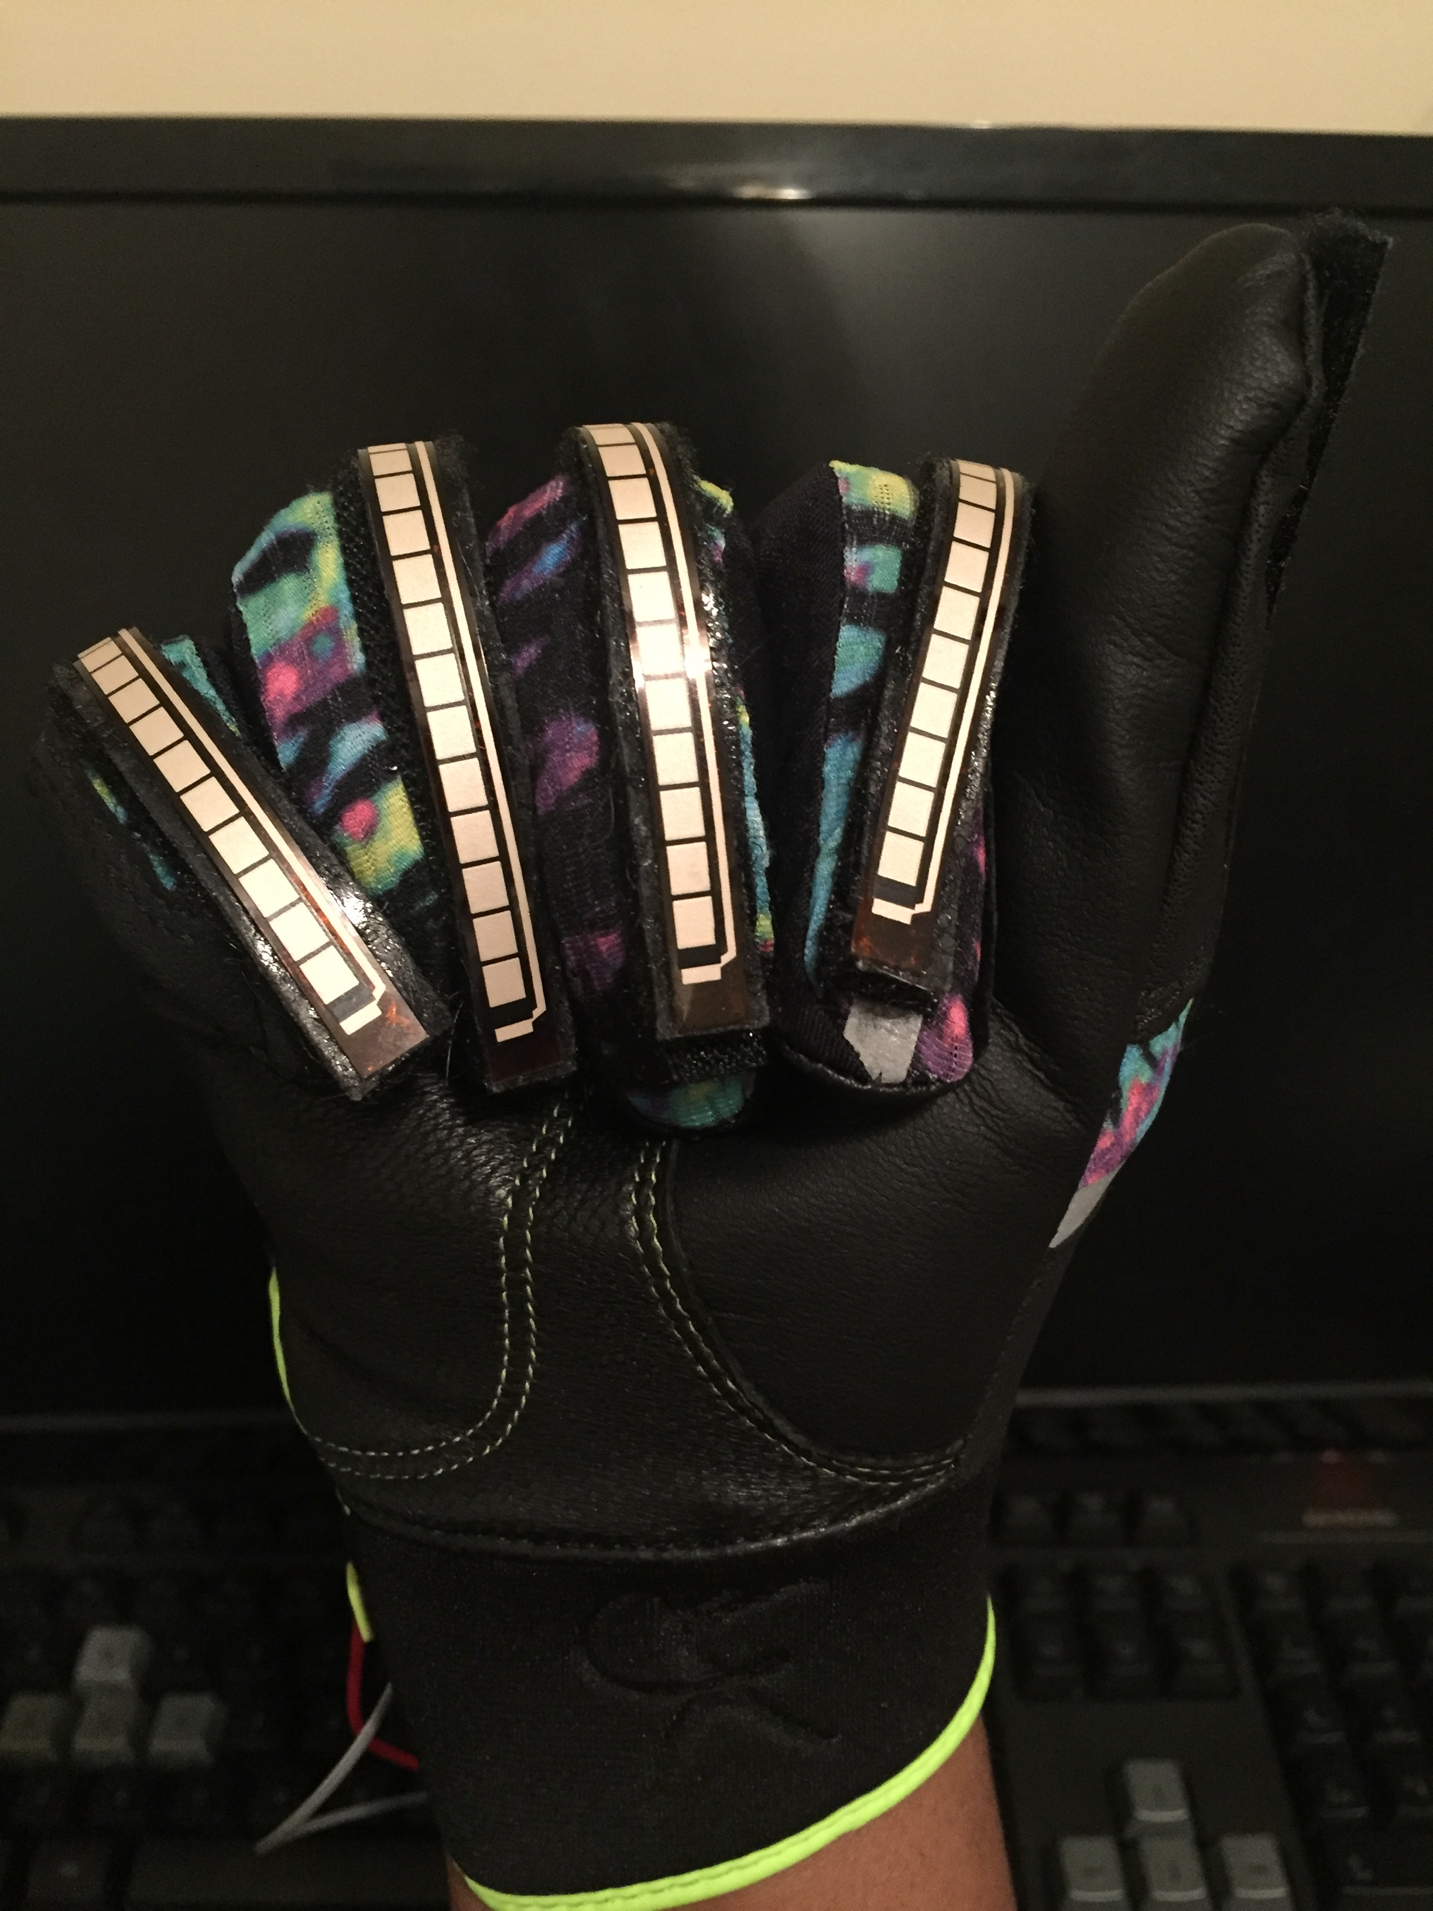
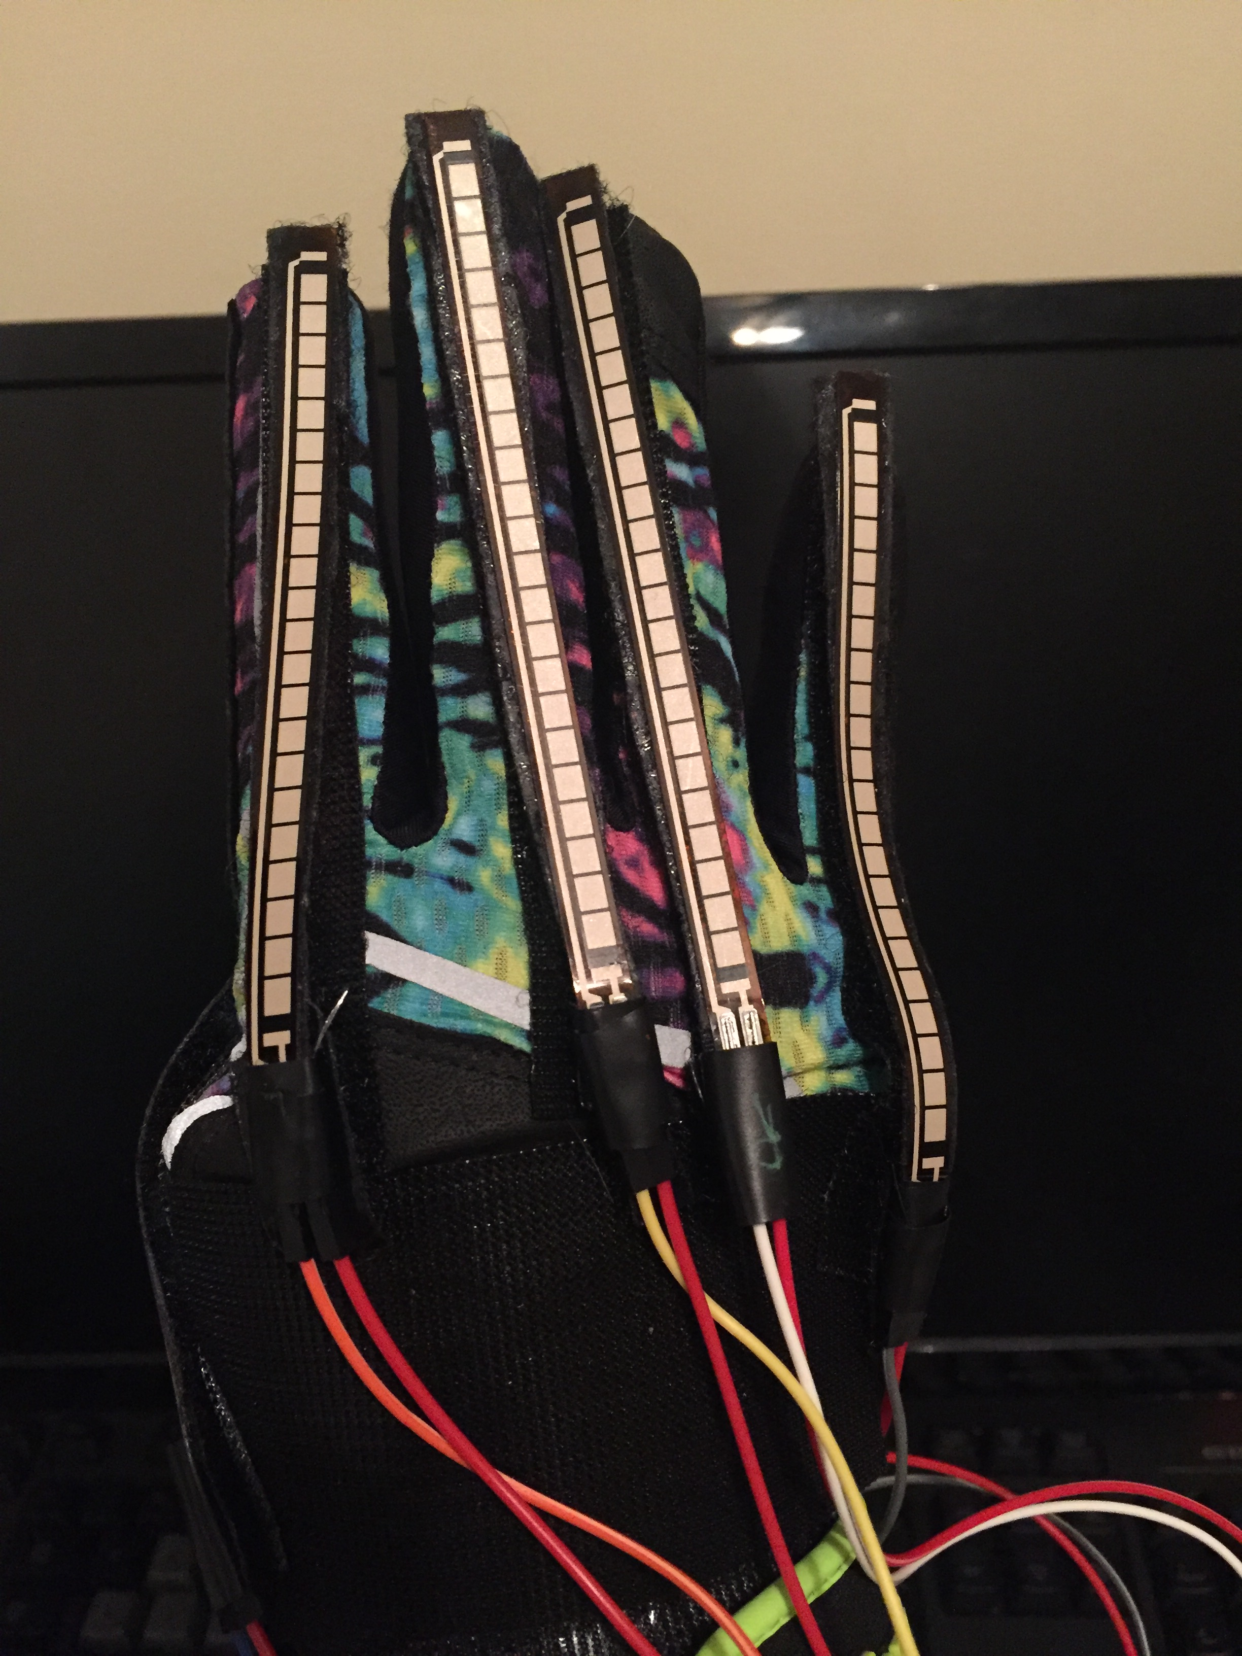
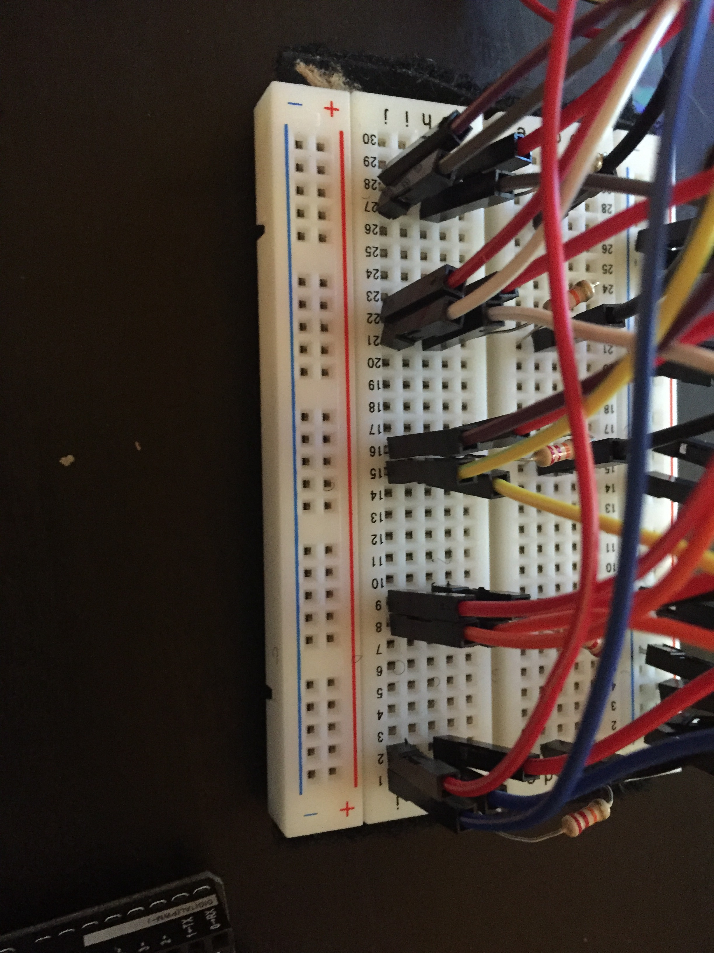
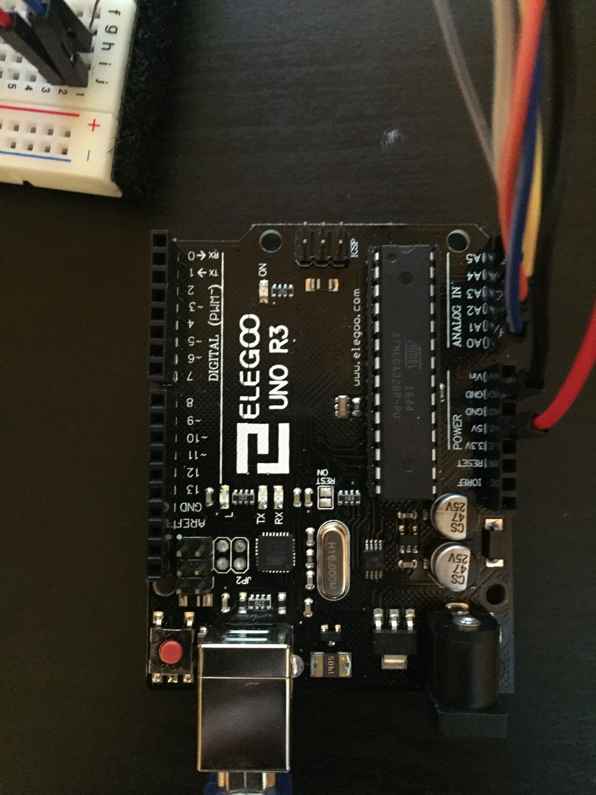
Ebisu: An Innovative User-Input Solution
Brittany Barnes and Yusef Ghouth
University of San Diego
Overview
Gestures
Machine Learning Algorithm
Ebisu is a user input device that ties together a wearable prototype, in the form of a glove, and a multiclass perceptron. Ebisu not only detects pre-learned gestures taken from American Sign Language or ASL, but learns custom gestures on the go and molds to the user over time. Adding a large set of new accessibility to the user’s digital devices and opening the door for innovative apps that work with the wearable input solution.
Ebisu’s Machine Learning algorithm is a Multiclass Perceptron: A neural Network designed to observe datasets and classify them as one of many pre-learned classes. The twist is Ebisu’s algorithm can also recognize new patterns and categorize them on the go, making it a much more versatile tool.
Input
“Yes” Gesture
“No” Gesture
“B”
“A”
Physical Prototype
Yes in ASL (front)
Yes in ASL (back)
Ebisu uses 5 flex sensors on each of the gloves’ fingers in order to measure the degree in which the fingers are bent. The flex sensors are attached to the glove using Velcro to allow for adequate bending of the sensors. The Arduino Uno and breadboard provides us with an outlet to receive the data and feed into the Perceptron.
Future Work
Full implementation of ASL Translation and commands.
Incorporating Accelerometer into Ebisu Glove to track the force of the gesture.
Creating a software suite that will allow Ebisu to directly control an operating system.
No in ASL (front)
No in ASL (back)
Gesturing
Data Generation
Perceptron Training
Gesture Recognition
Command Prompt
“A” in ASL
“B” in ASL
Notes:
Sat would like ASL defined in the overview section. I’m thinking something like, “Ebisu not only detects prelearned gestures within the American Sign Language…” or something like that. Or a new sentence using it

